Slide 1

Immunization (IZ) Validation Tool
Tutorial and Guide
Robert Snelick, Sandra Martinez
National Institute of Standards and Technology
May 30, 2012
Contact: rsnelick@nist.gov

Slide 2
http://hl7v2-iz-testing.nist.gov
Immunization Validation Tool Overview
  Purpose: The tool validates Immunization messages created by Electronic Health Records (EHR) technology and is intended for certifying 2014 Edition Meaningful Use EHR technology.
Tool Key Capabilities
Context-free Testing | (No Test Cases - Test any Immunization message created by EHR) Context is unknown to validation tool Provides a simple and convenient method for testing message structure and most vocabulary
Context-based Testing | (Test Cases - Test Immunization message associated with a specific test scenario) Context is known to validation tool All conformance requirements of the Immunization implementation guide can be assessed Used for certifying 2014 Edition Meaningful Use EHR technology
Profile Viewer | Provides a browsable version of the conformance profile which encapsulates the requirements. Can be used to assist in the interpretation of errors.
Vocabulary Browser | Provides a browsable view of the vocabulary requirements. Can be used to assist in the interpretation of value set errors.
Documentation | Provides access to documents which will assist in using the tool (including test procedure, test cases, profile descriptions, vocabulary descriptions and validation tool download).
  Get started today! No registration or log in credentials are needed. Simply click link on the link below and send/paste/load message into tool to obtain Validation report.
  NOTE: The Test Tool (.war file) can also be downloaded and installed locally.
  NOTE: Web Application is compatible with Firefox; Chrome; IE8; IE9
  More Info? Register to Google Group at: http://groups.google.com/group/hl7v2-immunization-testing to ask questions and provide feedback.

Slide 3
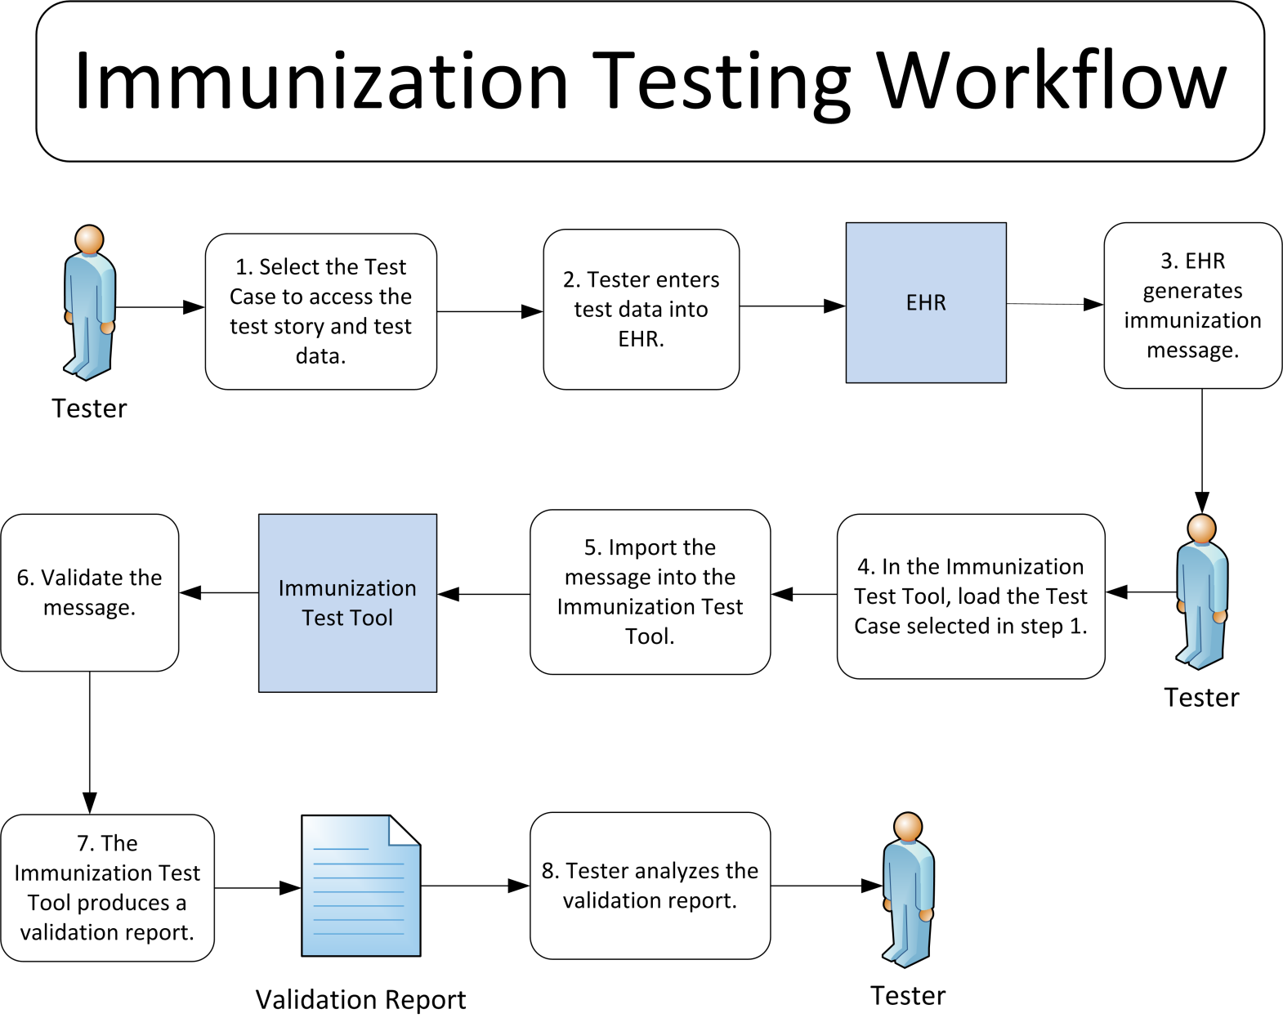
Immunization Testing Process

Slide 4
Immunization Context-free
Test Scenario Walk Through Tool Demonstration

Slide 5
Immunization Context-free Testing Work Flow (Step by Step)
1) Import test message
Open Immunization Validation tool using link: http://hl7v2-iz-testing.nist.gov. Click on Context-free Validation tab. Click on Browse Message button to load message into Message Content window. Message Uploader Dialog window displays. Click on Select Message button. Open test message file to upload it.
2) Validate test message and review message validation errors
Uploaded test message displays. If message fails validation, errors will display in Message Validation Result section of page. Click on location link to highlight the data element causing the error within the Message Tree and Content. Description explains why error occurred. Format or table of data element may be provided. Line number and column of errors are provided. Click on page numbers to view additional pages of errors. Location link displays the location of the data element.
3) Look up valid data element values and tables
Click on Profile Viewer tab. Select R, RE, C (Only) to view only required, required but may be empty and conditional elements. Select R, RE, C, O, X (All) to view all data elements, including optional and not supported elements. Click on a tab to filter data elements by segment. Locate data element using element name from the location link. Make a note of the table ID. Click on Vocabulary tab. Locate and select table ID. Valid values are listed. Click on Context-free Validation tab to return to message.

Slide 6

Immunization Context-free Testing Work Flow
In the next few slides, this test scenario will walk through the steps needed to:
  Import test message
  Validate test message and review message validation errors
  Look up valid data element values and tables
  Import test message
Open Validation tool
Message Uploader Dialog window displays
Click Context-free Validation page
Click on Select Message button
Click on Browse Message button to load test message
Open test message file
Next Slide

Slide 7
Immunization Context-free Testing Work Flow (cont’d)
2) Validate test message and review message validation errors
3) Look up valid data element values and tables
Validation page displays uploaded test message
Click on Profile Viewer tab
Click on Vocabulary tab
Message validation results display
Locate data element to review information
Locate and select table ID
If table ID is listed, take note of table ID
Valid values for data element display
Review error info displayed in Message Validation Result section
Click on Context -free Validation tab to return to message
Click on location link to highlight data element causing error
Work flow is complete

Slide 8
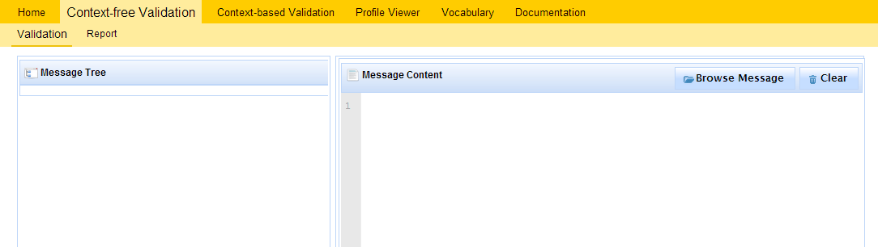
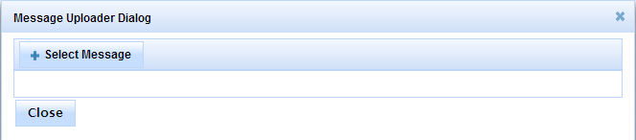
1) Import test message
Context-free Validation page
This page validates any Immunization message. It is disassociated from a test script, test case, or specific content. Testing will include the technical requirements and content-specific requirements specified in the selected profile.
1
Open Immunization Validation tool using link: http://hl7v2-iz-testing.nist.gov.
2
Click on Context-free Validation tab.
3
Click on Browse Message button to load message into Message Content window.
4
Message Uploader Dialog window displays.
5
Click on Select Message button.
6
Open test message file to upload it.

Slide 9
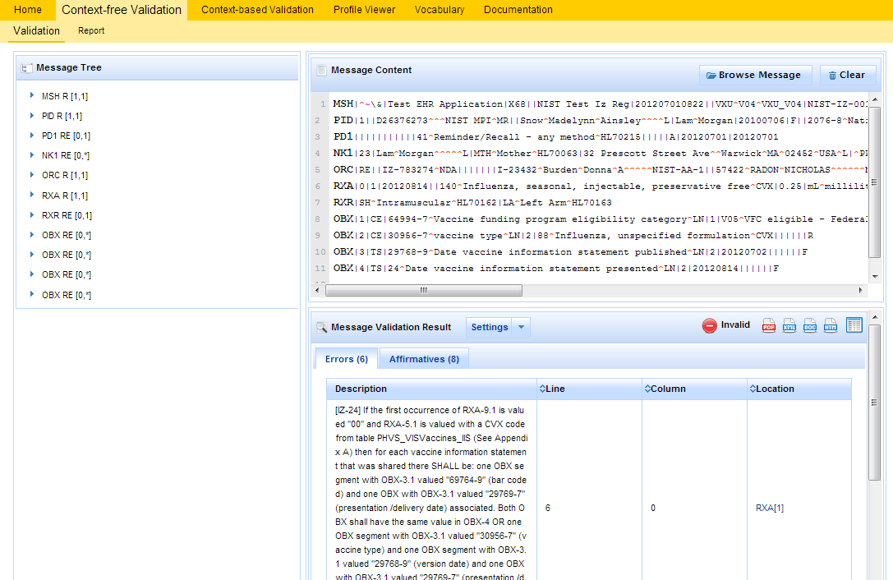
2) Validate test message and review message validation errors
1
Uploaded test message displays.
2
If message fails validation, errors will display.
3
Click on location link to highlight the data element causing the error within the Message Tree and Content.
Note: Location link may not be available if the message element location does not map to a message element in the message tree.

Slide 10
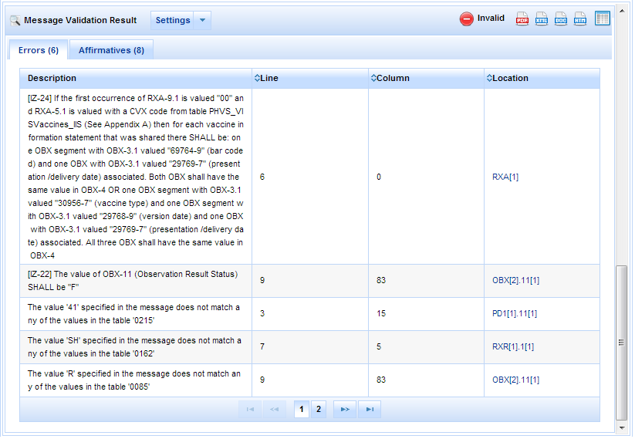
2) Validate test message and review message validation errors (cont’d)
4
Total number of errors displays.
5
Description explains why error occurred. Format or table of data element may be provided.
6
Line number and column of errors are provided.
7
Location link displays the location of the data element.
8
Click on page numbers to view additional pages of errors.

Slide 11
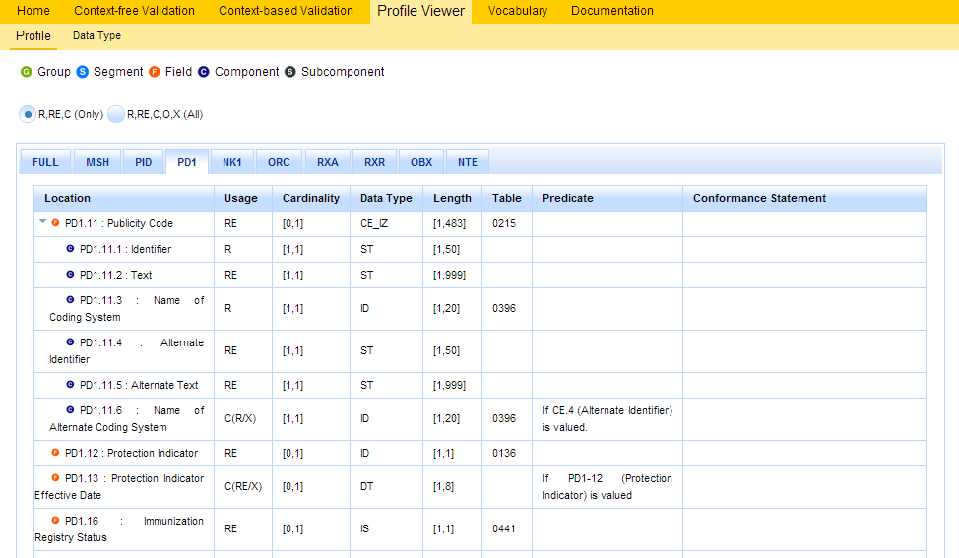
3) Look up valid data element values and tables
1
Click on Profile Viewer tab.
2
Data elements may be filtered by Usage.
Select R, RE, C (Only) to view only required, required but may be empty and conditional elements.
Select R, RE, C, O, X (All) to view all data elements, including optional and not supported elements.
3
Click on a tab to filter data elements by segment.
The Full tab displays data elements of all segments.
4
Locate data element using element name from the location link.
Profile Viewer page
This page allows tester to view data element information including usage, cardinality, data type, length, table, condition predicate and conformance statements.
5
Usage will indicate whether data element is required. The value RE indicates it is but may be empty.
6
Minimum and maximum valid lengths of data element are listed.
7
Make a note of the table ID.

Slide 12
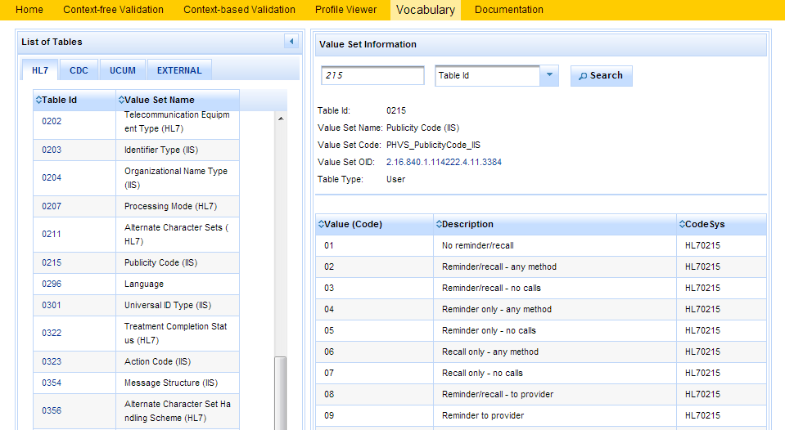
3) Look up valid data element values and tables (cont’d)
8
Click on Vocabulary tab.
11
Use the search box to search for value code, value set, table name, table ID or description.
9
Locate and select table ID.
10
Valid values are listed.
Vocabulary page
This page provides the ability to browse the vocabulary requirements. Search capabilities are provided and include searching on value, table name, table ID and description.
12
Click on Context-free Validation tab to return to message.

Slide 13
Immunization Context-based
Test Scenario Walk Through Tool Demonstration

Slide 14
Immunization Context-based Testing Work Flow (Step by Step)
1) Select Test Case and Review Test Story
Open Immunization Validation tool using link: http://hl7v2-iz-testing.nist.gov. Click on Context-based Validation tab. Click on arrows to expand the Test Scenarios and Test Cases. Click on a Test Step. Test Story displays.
2) Review Test Data Specification and Message Content
Click on Test Data Specification tab. Full tab is selected by default. To view a specific section, click on a tab. Relevant real-world clinical data is displayed. Click on Message Content tab. Location specifies the location of a data element within the message. Name of data element is provided. Exact value of the data element for the selected Test Step is provided. Categorization indicates if the data is fixed or can be changed.
3) Create test message
Using the EHR technology, create the Immunization test message with the test data provided for the selected Test Step (step 2).
4) Load Test Step and import test message
Click on Select button to load the Test Step. Validation page displays. Click on Browse Message button. Message Uploader Dialog window displays. Click on Select Message button. Open test message file created in step 3 to upload it.

Slide 15
Immunization Context-based Testing Work Flow (Step by Step – cont’d)
5) Validate test message and review validation errors message
Uploaded test message displays. If message fails validation, errors will display in Message Validation Result section of page. Click on location link to highlight the data element causing the error within the Message Tree and Content. Description explains why error occurred. Format or table of data element may be provided. Line number and column of errors are provided. Click on page numbers to view additional pages of errors. Location link displays the location of the data element.
6) Generate Message Validation Report
Click on Report Details icon to display Message Validation Report. Message Validation Report may be downloaded as a PDF, XML, Word doc, HTML file. Message Validation Report may be printed.
7) Look up valid data element values and tables
Click on Profile Viewer tab. Select R, RE, C (Only) to view only required, required but may be empty and conditional elements. Select R, RE, C, O, X (All) to view all data elements, including optional and not supported elements. Click on a tab to filter data elements by segment. Locate data element using element name from the location link. Make a note of the table ID. Click on Vocabulary tab. Locate and select table ID. Valid values are listed. Click on Context-based Validation tab to return to message.

Slide 16

Immunization Context-based Testing Work Flow
In the next few slides, this test scenario will walk through the steps needed to:
  Select Test Case and Review Test Story
  Review Test Data Specification and Message Content
  Create Test Message
  Load Test Step and import test message
  Validate test message and review validation errors
  Generate Message Validation Report
  Look up valid data element values and tables
1) Select Test Case and Review Test Story
2) Review Test Data Specification and Message Content
3) Create Test Message
Open Validation tool
Click on Test Data Specification tab
Click on Message Content tab
Create test message using EHR technology and test data provided
Select Test Case
Review data elements of test message
Review segment information of test message
Review Test Story
Next Slide

Slide 17
Immunization Context-based Testing Work Flow (cont’d)
4) Load Test Step and import test message
5) Validate test message and review validation errors
6) Generate Message Validation Report
Click on Select button to load Test Step
Message Uploader Dialog window displays
Validation page displays uploaded test message
Click on Report Details icon
Message validation results display
Message Validation Report displays
Validation page displays
Click on Select Message button
Click on Browse Message button
Open test message file created in step 3
Review error info displayed in Message Validation Result section
Click on location link to highlight data element causing error
Next Slide

Slide 18
Immunization Context-based Testing Work Flow (cont’d)
7) Look up valid data element values and tables
Click on Profile Viewer tab
Click on Vocabulary tab
Locate data element to review information
Locate and select table ID
If table ID is listed, take note of table ID
Valid values for data element display
Click on Context-based Validation tab to return to message
Work flow is complete

Slide 19
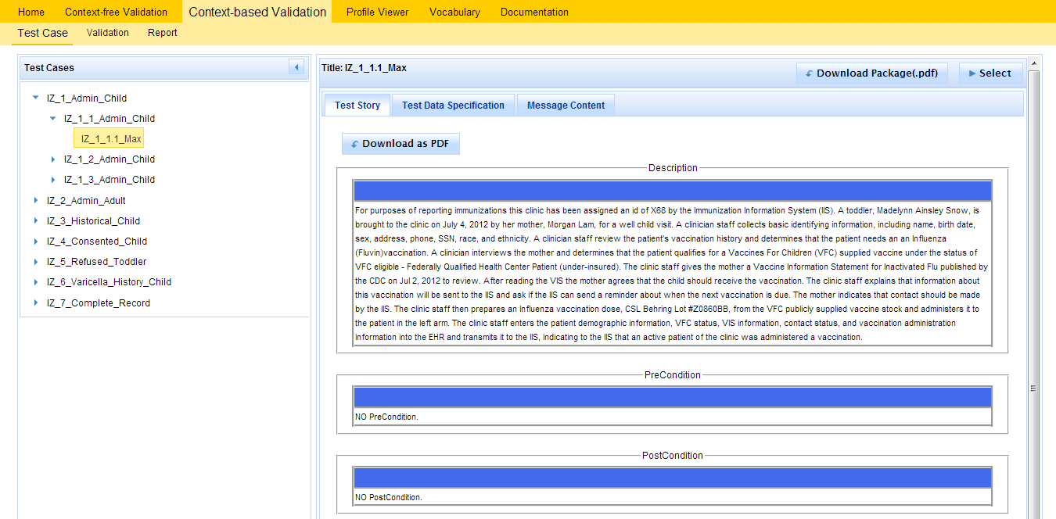
1) Select Test Case and Review Test Story
1
Open Immunization Validation tool using link: http://hl7v2-iz-testing.nist.gov.
2
5
6
Click on Context-based Validation tab.
Test Story may be downloaded as a PDF file.
Test Case Package may be downloaded as a PDF file.
3
Click on arrows to expand the Test Scenarios and Test Cases. Click on a Test Step.
4
Test Story displays.

Slide 20
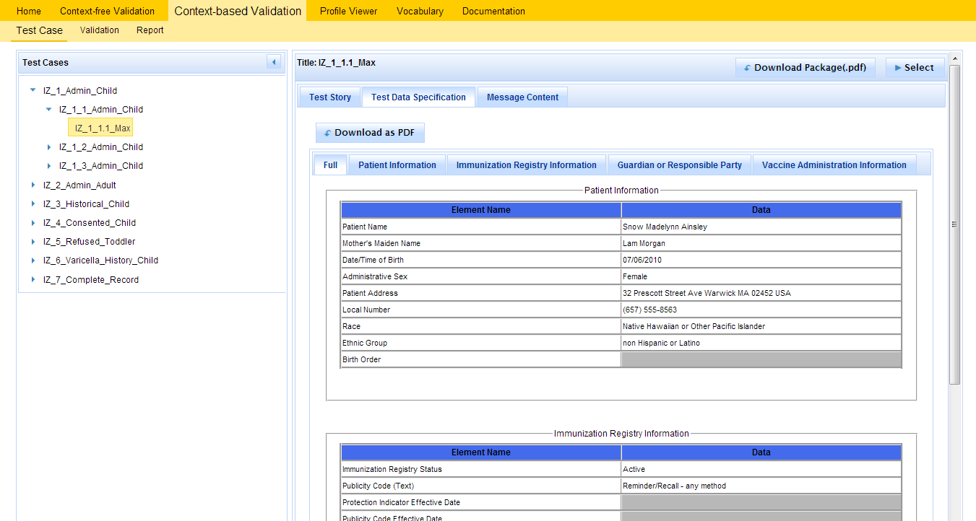
2) Review Test Data Specification and Message Content
4
Test Data Specification may be downloaded as a PDF file.
1
Click on Test Data Specification tab.
2
Full tab is selected by default. To view a specific section, click on a tab.
3
Relevant real-world clinical data is displayed.
Test Data Specification page
This page specifies the data that are entered (automatically/manually) into the EHR and included in the message that is created and submitted from the EHR to the Immunization validation tool. The tester shall identify an existing patient record in the EHR or shall create a patient record in the EHR using the data in the Data Sheet associated with the Test Case.

Slide 21
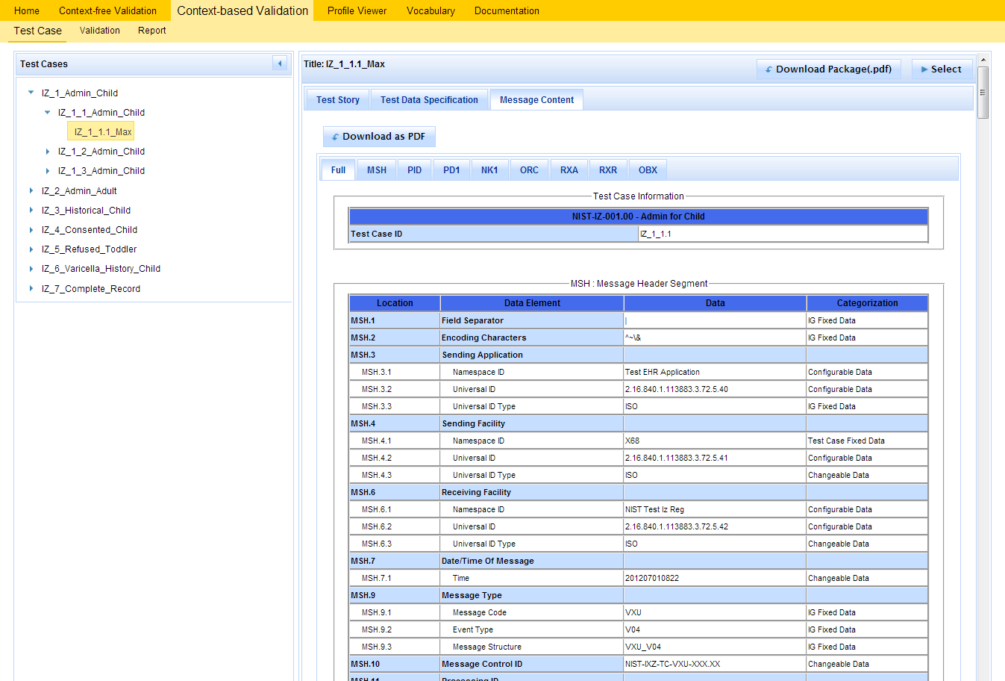
2) Review Test Data Specification and Message Content (cont’d)
5
Click on Message Content tab.
6
Location specifies the location of a data element within the message.
7
10
Message Content may be downloaded as a PDF file.
Name of data element is provided.
8
Exact value of the data element for the selected Test Step is provided.
9
Categorization indicates if the data is fixed or can be changed.
Message Content page
This page provides details of the message segment, as well as an example of a valid instance of each data element.
3) Create test message
1
Using the EHR technology, create the Immunization test message with the test data provided for the selected Test Step (step 2).

Slide 22
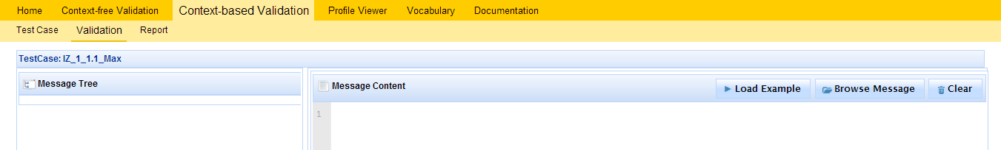
4) Load Test Step and import test message
1
Click on Select button to load the Test Step.
2
Validation page displays.
3
Click on Browse Message button.
4
Message Uploader Dialog window displays.
5
Click on Select Message button.
6
Open test message file created in step 3 to upload it.

Slide 23
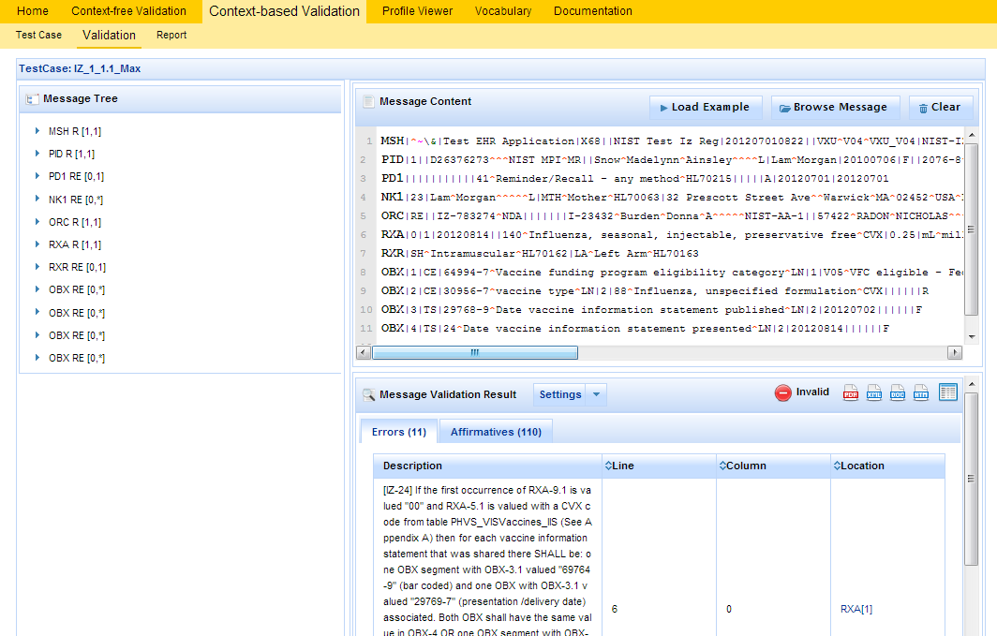
5) Validate test message and review validation errors
1
Uploaded test message displays.
2
If message fails validation, errors will display.
3
Click on location link to highlight the data element causing the error within the Message Tree and Content.
Note: Location link may not be available if the message element location does not map to a message element in the message tree.

Slide 24
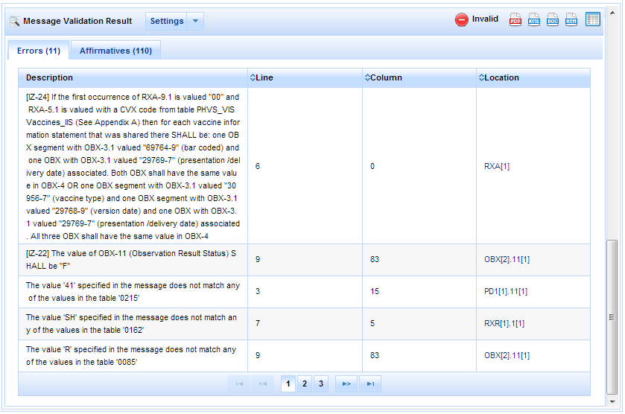
5) Validate test message and review validation errors (cont’d)
4
Total number of errors displays.
5
Description explains why error occurred. Format or table of data element may be provided.
6
Line number and column of errors are provided.
7
Location link displays the location of the data element.
8
Click on page numbers to view additional pages of errors.

Slide 25
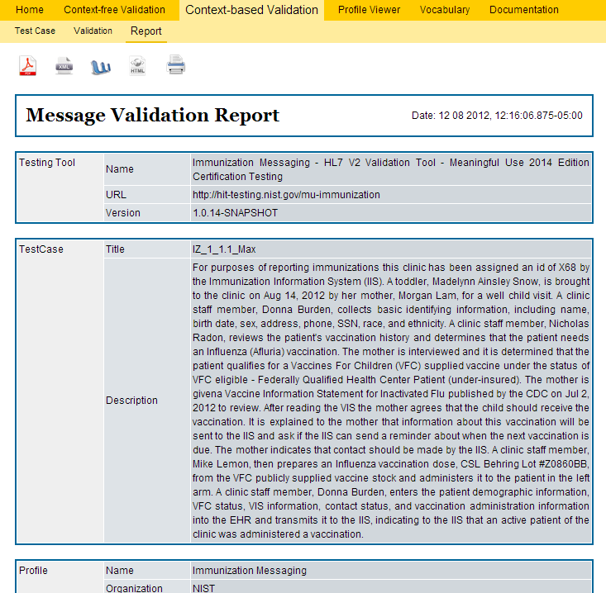
6) Generate Message Validation Report
1
Click on Report Details icon to display Message Validation Report.
2
Message Validation Report may be downloaded as a PDF, XML, Word doc, HTML file.
3
Message Validation Report may be printed.

Slide 26
7) Look up valid data element values and tables
1
Click on Profile Viewer tab.
2
Data elements may be filtered by Usage.
Select R, RE, C (Only) to view only required, required but may be empty and conditional elements.
Select R, RE, C, O, X (All) to view all data elements, including optional and not supported elements.
3
Click on a tab to filter data elements by segment.
The Full tab displays data elements of all segments.
4
Locate data element using element name from the location link.
Profile Viewer page
This page allows tester to view data element information including usage, cardinality, data type, length, table, condition predicate and conformance statements.
5
Usage will indicate whether data element is required. The value RE indicates it is but may be empty.
6
Minimum and maximum valid lengths of data element are listed.
7
Make a note of the table ID.

Slide 27
7) Look up valid data element values and tables (cont’d)
8
Click on Vocabulary tab.
11
Use the search box to search for value code, value set, table name, table ID or description.
9
Locate and select table ID.
10
Valid values are listed.
Vocabulary page
This page provides the ability to browse the vocabulary requirements. Search capabilities are provided and include searching on value, table name, table ID and description.
12
Click on Context-based Validation tab to return to message.

Slide 28
Other Utilities

Slide 29
Other Utilities
Message Validation Report
The Message Validation Report is the output of the Immunization Test Tool. This report states if the test message has passed or failed the test and identifies the points of failure.
1
Message Validation Report may be downloaded as a PDF, XML, Word or HTML file.
2
Message Validation Report may be printed.
3
4
Scroll through report to view data that passed validation and any errors.
Click on Validation to go back to the message.

Slide 30
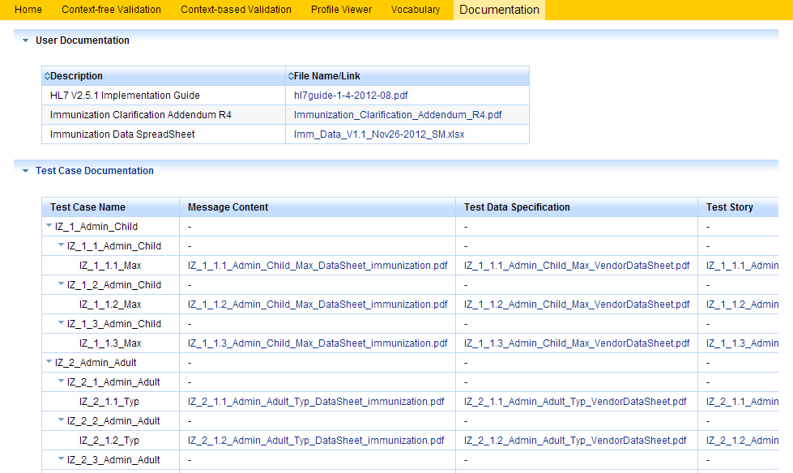
Other Utilities
Documentation page
The Documentation page provides the ability to download all documents and files for testing, including Data Spreadsheet, Test Cases, Profile and Vocabulary Description files, and validation tool application file (.war file).

Slide 31
Addendum: VIS Approaches

Slide 32
Immunization Test Tool VIS Approach Options
Immunization Test Tool supports Vaccine Information Statements (VIS) for single and multi-vaccines via two approaches
  Vaccine Type
  Global Document Type Identifier (GDTI) 3D Barcode
The Tester indicates the VIS approach to be used for validation by choosing either “Vaccine Type Approach” or “GDTI Approach” from the Select Approach drop-down menu on the Validation page*
“Vaccine Type Approach” is the default option
  The Message Content specification shows the Vaccine Type Approach
  The default Example message shows the Vaccine Type Approach
“GDTI Approach” is activated when selected by the Tester
  No Message Content specification is provided for the GDTI Approach
  If “GDTI Approach” is selected by the Tester, the GDTI Approach Example message becomes accessible via the “Load Example” button and provides message content guidance for a GDTI message instance
*See screen shots on next slide showing this new capability

Slide 33
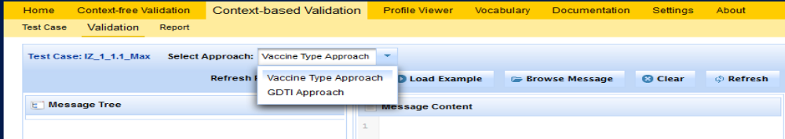
Immunization Test Tool Screen for VIS Approach Options
The Tester selects the desired VIS Approach from the drop-down menu provided on the Validation page in the Test Tool
1
Click on Select button to load the Test Step.
2
Validation page displays.
3
Select Approach from drop down menu.
4
Click on Browse Message button.
5
Message Uploader Dialog window displays.
6
Click on Select Message button.
7
Open test message file created in step 3 to upload it.

